Slide 1
Priority Queues
Md Amjad Hossain
Slides are from Ahmed Al-Baghdadi , Kent State University
https://www.cs.kent.edu/~aalbaghd/DAAFall21.html

Slide 2
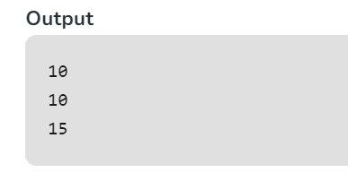
Java Code Example- Priority Queue
// Java program to demonstrate the
// working of PriorityQueue
import java.util.*;
class PriorityQueueDemo {
// Main Method
public static void main(String args[])
{
// Creating empty priority queue
PriorityQueue<Integer> pQueue = new PriorityQueue<Integer>();
// Adding items to the pQueue using add()
pQueue.add(10);
pQueue.add(20);
pQueue.add(15);
// Printing the top element of PriorityQueue
System.out.println(pQueue.peek());
// Printing the top element and removing it
// from the PriorityQueue container
System.out.println(pQueue.poll());
// Printing the top element again
System.out.println(pQueue.peek());
}
}
Its not FIFO
Based on the priority- say lowest value has highest priority.

Slide 3
Priority Queue ADT
Stores a collection of (key, element) pairs
Main methods
insertItem(k, o): inserts an item with key k and element o
removeMin(): removes the item with smallest key and returns its element.
minKey(): returns, but does not remove, the smallest key of an item
minElement(): returns, but does not remove, the element of an item with smallest key
size(), isEmpty()
Applications:
Multithreading
Triage in Hospital

Slide 4
Keys must be comparable
Keys in a priority queue can be arbitrary objects on which a total order relation is defined
A generic priority queue uses an auxiliary Comparator ADT
Encapsulates the action of comparing two objects according to a given total order relation
The comparator is external to the keys being compared
When the priority queue needs to compare two keys, it uses its comparator
isLessThan (x,y)
isLessThanOrEqualTo(x,y)
isEqualTo(x,y)
isGreaterThan(x, y)
isGreaterThanOrEqualTo(x,y)

Slide 5
Suppose you are given a priority queue implementation, so you have the following operations to work with:
Implementation
insertItem(k, o) removeMin() minKey() minElement() size() isEmpty()
How can you use it to sort a sequence S of numbers?

Slide 6
Sorting with a Priority Queue
We can use a priority queue to sort a set of comparable elements
Insert the elements one by one with a series of insertItem(e, e) operations
Remove the elements in sorted order with a series of removeMin() operations
Algorithm PQ-Sort(S, C)
Input sequence S, comparator C for the elements of S
Output sequence S sorted in increasing order according to C
P ← priority queue with comparator C
while ¬S.isEmpty ()
e ← S.remove (S. first ())
P.insertItem(e, e)
while ¬P.isEmpty()
e ← P.removeMin() S.insertLast(e)
Running time depends on the priority queue implementation

Slide 7
Sequence-based Priority Queue
Implementation with an unsorted sequence
4 5 2 3 1
Store the items of the priority queue in a list-based sequence, in arbitrary order
insertItem takes O(1) time since we can insert the item at the beginning or end of the sequence
removeMin, minKey and minElement take O(n) time since we have to traverse the entire sequence to find the smallest key
Implementation with a sorted sequence
1 2 3 4 5
Store the items of the priority queue in a sequence, sorted by key
insertItem takes O(n) time since we have to find the place where to insert the item
removeMin, minKey and minElement take O(1) time since the smallest key is at the beginning of the sequence

Slide 8
Selection-Sort
Selection-sort is the variation of PQ-sort where the priority queue is implemented with an unsorted sequence
Running time of Selection-sort:
Inserting the elements into the priority queue with n insertItem operations takes O(n) time
Removing the elements in sorted order from the priority queue with n removeMin operations takes time proportional to
1 + 2 + …+ n
Runs in O(n²) time
4 5 2 3 1

Slide 9
Insertion-Sort
Insertion-sort is the variation of PQ-sort where the priority queue is implemented with a sorted sequence
Running time of Insertion-sort:
Inserting the elements into the priority queue with n insertItem operations takes time proportional to
1 + 2 + …+ n
Removing the elements in sorted order from the priority queue with a series of n removeMin operations takes O(n) time
Runs in O(n²) time
1 2 3 4 5

Slide 10
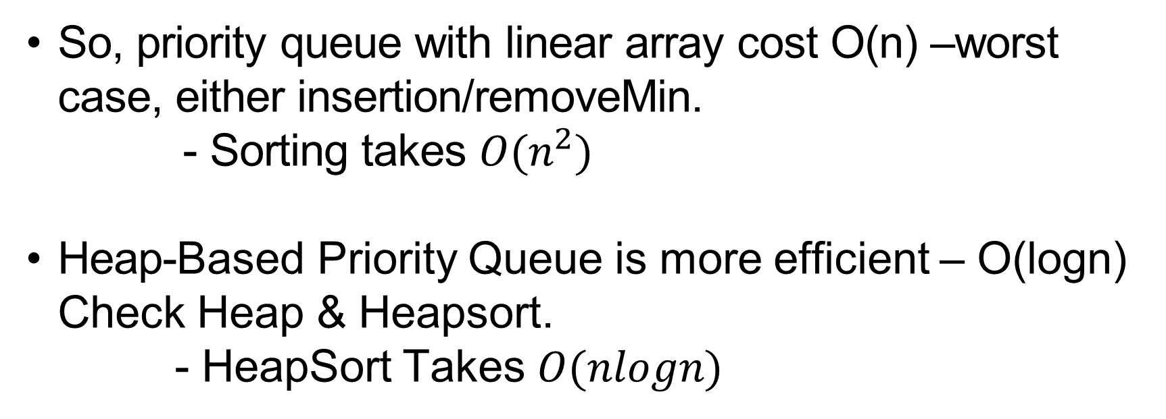
So, priority queue with linear array cost O(n) –worst case, either insertion/removeMin.
- Sorting takes $O(n^{2})$
Heap-Based Priority Queue is more efficient – O(logn) Check Heap & Heapsort.
- HeapSort Takes $O(nlogn)$

